Slide 1




First Steps in Software Testing
Testing objectives, project investigation and unexpected behavior
QA
Fundamentals
Ivan Yonkov
Technical Trainer
http://github.com/RoYaLBG
Software University
http://softuni.bg

Slide 2

Table of Contents
What is Testing?
Testing Objectives
Project Investigation
Project objectives
Functional branches
User Experience
Unexpected Behavior
Integrating QA Into Working Process

Slide 3

Software Testing

Slide 4
Software testing
Software testing is an investigation conducted to provide stakeholders with information about the quality of the product or service under test

Slide 5

Software testing (2)
First coined as a term in 1979
Introduced by G. J. Myers as a separation from debugging
First aimed to breakage testing
Stages of software testing phases
Until 1956 – Debugging oriented
1957–1978 – Demonstration oriented
1979–1982 – Destruction oriented
1983–1987 – Evaluation oriented
1988–2000 – Prevention oriented

Slide 6

Testing Objectives

Slide 7
Testing Objectives
Ensures software should
Meet design and development requirements
Respond correctly to user input
Perform its functions on time
Be usable sufficiently
Install and run on environments
Achieve the general stakeholders desired result

Slide 8

Project Investigation

Slide 9
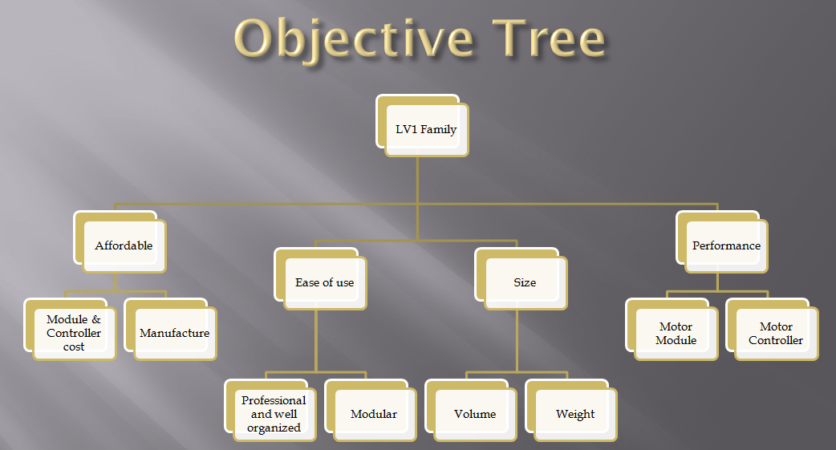
Project Investigation
Examine project objectives
Main project goal
Determine mini-goals
Target audience
Limitations

Slide 10
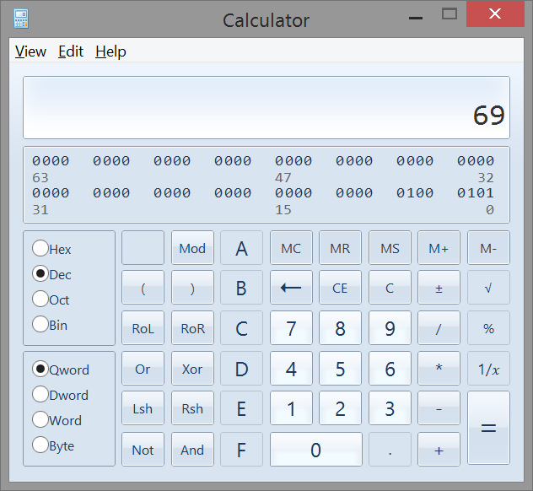
Project Investigation (2)
Functionality map

Slide 11
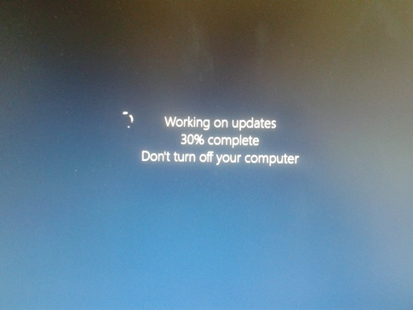
Project investigation (3)
User experience

Slide 12
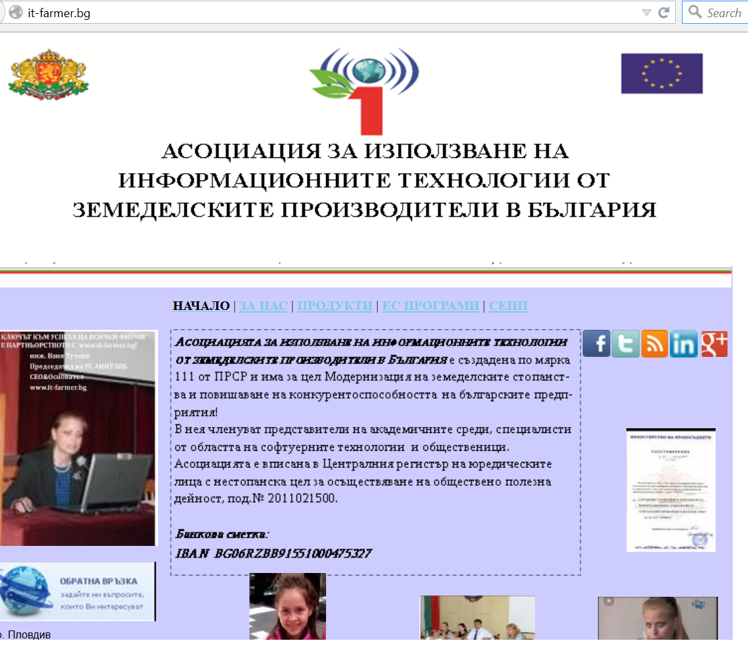
Project Investigation (4)
User experience

Slide 13

Unexpected Behavior

Slide 14
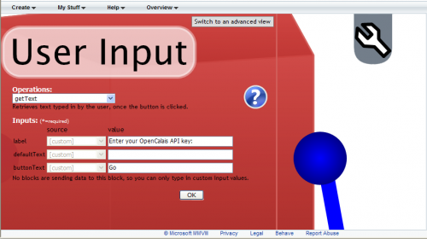
Unexpected behavior
User input
Intentional input
Arbitrary input

Slide 15
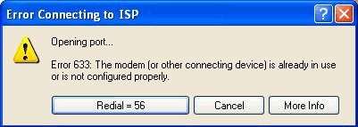
Unexpected behavior
Force majeure
Lack of internet connection
Different locale settings

Slide 16
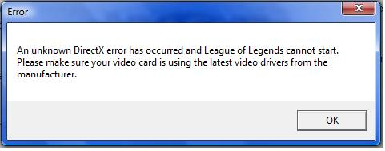
Unexpected Behavior
System requirements
Platform dependency
Drivers
Libraries

Slide 17
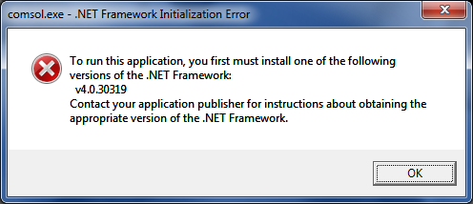
Unexpected Behavior (2)

Slide 18

Working Process

Slide 19
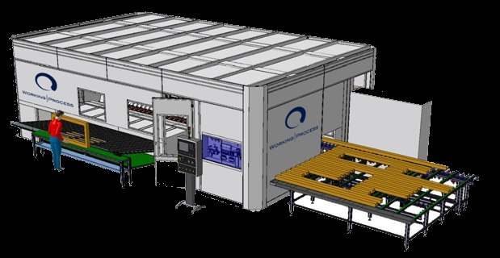
Working Process
Generally, processes involve combination of
People
Machines
Tools
Techniques
Materials
Way of communication

Slide 20
Working process
QA is involved into the communcation between the project manager and the developer
Reviewing business requirements
Ensuring bug fixing
Observing the development process

Slide 21

Summary
Introduction to software testing
What is testing
Testing objectives
Working on projects
Determine project objectives
Make functionality map
Check user experience

Slide 22
Summary (2)
Find unexpected behavior
User input
Force majeure
System requirements
Working processes
Glue in the communication

Slide 23









First steps in software testing
http://softuni.org/courses

Slide 24
License
This course (slides, examples, demos, videos, homework, etc.) is licensed under the "Creative Commons Attribution-NonCommercial-ShareAlike 4.0 International" license
Attribution: this work may contain portions from
"Fundamentals of Computer Programming with C#" book by Svetlin Nakov & Co. under CC-BY-SA license
"C# Part I" course by Telerik Academy under CC-BY-NC-SA license

Slide 25





Free Trainings @ Software University
Software University Foundation – softuni.org
Software University – High-Quality Education, Profession and Job for Software Developers
softuni.bg
Software University @ Facebook
facebook.com/SoftwareUniversity
Software University @ YouTube
youtube.com/SoftwareUniversity
Software University Forums – forum.softuni.bg

